Slide 1



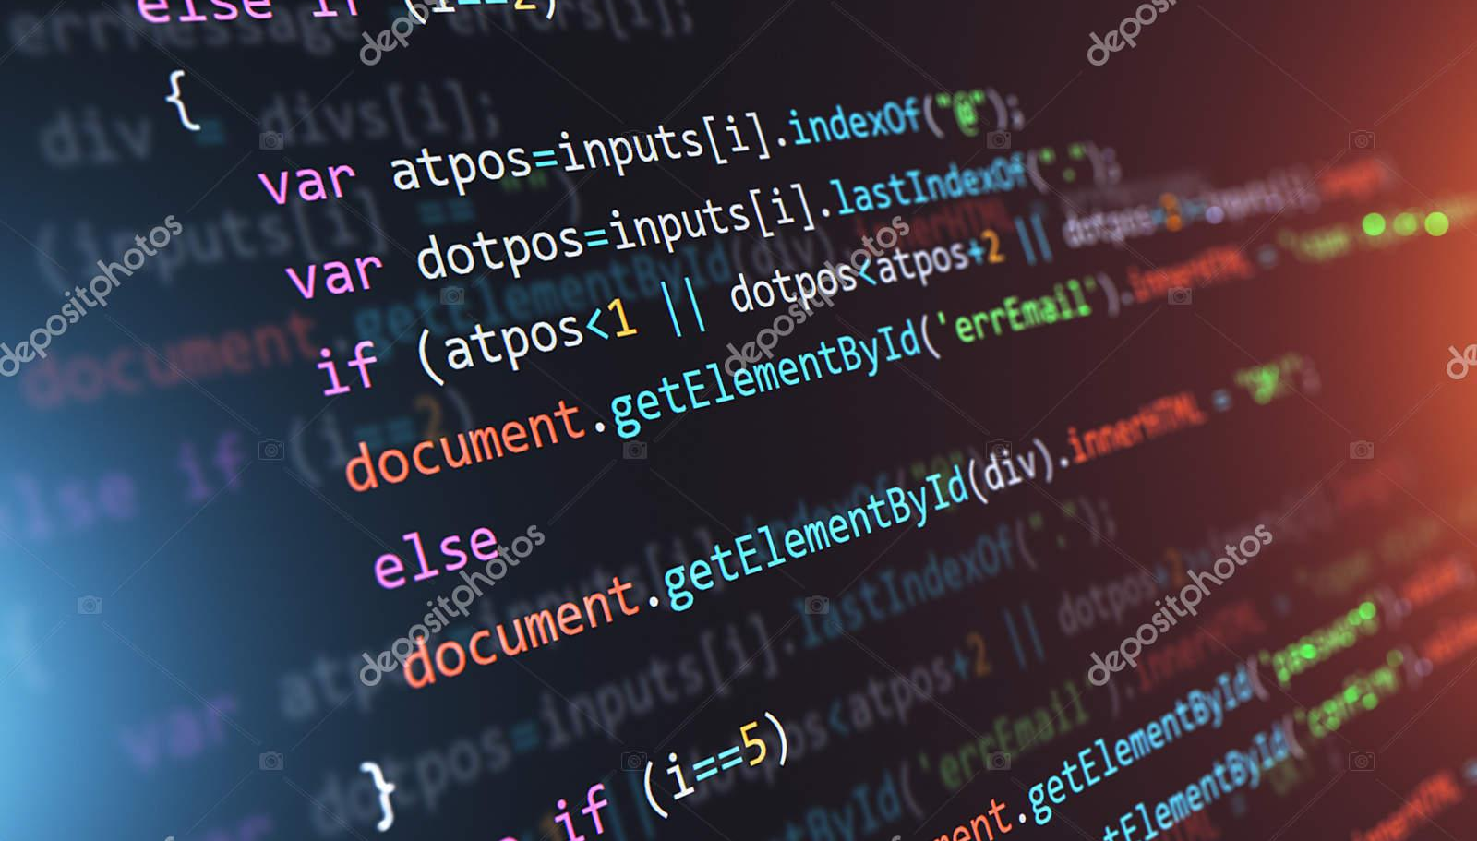


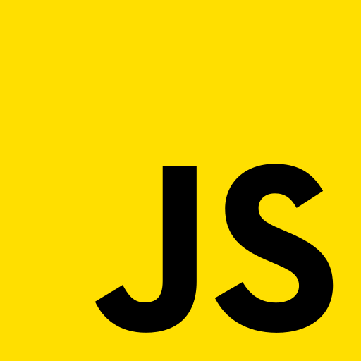


Scripting Languages
CSC 331 Project - Group 3

Slide 2
Outline
Introduction to Scripting Languages
Overview of Scripting Languages
A Case Study on Scripting Languages (Python)
Conclusion

Slide 3
INTRODUCTION
What is a Script?
What are Scripting Languages?
History of Scripting Languages

Slide 4
What are Scripting Languages?
What is a Script?
Scripting languages are a type of programming language used to write scripts or small programs that automate specific tasks or processes.
A script is a program or sequence of instructions written in a scripting language that can be executed within a specific runtime environment.
Notes:
Explain a script in terms of executable environment

Slide 5
History of Scripting Languages
Job Control Language
IBM 1130's conversational monitor system (CMS) and the Burroughs B5000's Master Control Program (MCP) were early scripting languages used for job control and system administration tasks.
Perl, Python & PHP
Perl was developed for text processing & system administration tasks. Python was designed to be easy to read and write, making it popular for both system administration tasks & app development. PHP was designed specifically for web development, with a focus on server-side scripting.
Awk Language
The Awk language, developed by Alfred Aho, Peter Weinberger, and Brian Kernighan was designed for text processing and data extraction, and it became popular in the Unix community.
1970
1980
2000
1960
1975
1990
Unix & Shell Scripts
Unix and shell scripting languages like Bourne shell (sh), C shell (csh), and Korn shell (ksh) were used to automate system administration tasks and to write small programs.
TCL
Tcl (Tool Command Language), which was developed in 1988 by John Ousterhout was used for creating simple graphical user interfaces and for embedding scripting into other applications.
JavaScript & Ruby
Javascript, originally developed in 1995, became widely used in web development, particularly for client-side scripting. Ruby, also developed in the 1990s, became popular in the 2000s for web development and as the foundation for the Ruby on Rails web framework.

Slide 6
OVERVIEW OF SCRIPTING LANGUAGES
Key Features of Scripting Languages
Types of Scripting Languages

Slide 7

Key features of Scripting Languages
Dynamic Typing
Variables’ type are determined at runtime
Large Standard Library
Set of pre-written tools/functions that can be used to speed up development
Built-in Data Structure
Such as Arrays, Maps, Set
Interactive Interpreter
Allows programmer to execute instruction line by line and see results in real-time.
Cross Platform Compatibility
Write once, run anywhere

Slide 8
Types of Scripting Languages
For writing Scripts that runs on the client (i.e Browser) e.g. JavaScript, AJAX, HTML, VBScript,
Client Side Languages
Scripting Languages
Server Side Languages
For writing programs that runs on a web server. Used for data processing and manipulation. Example: PHP, Python, Perl, Ruby
Notes:
Establish that scripting languages can be categorised in many different ways with some degree of overlaps. This categorizations is based on web development. Other categorization include:
Glue languages
Job control languages and shells: controlling the behavior of system programs eg. Bash and Batch Scripts
GUI scripting
Application-specific languages
Extension/embeddable languages

Slide 9

PYTHON - A Case Study on Scripting Languages
Brief Overview
Unique Features
How Python codes are executed
Python Lexical and Syntax Analysis

Slide 10
Python Language
Python is a general purpose high level language first released in 1991
Designed by Guido Van Rossum and maintained by the Python Software Foundation
Design Philosophy
Code readability (achieved by the extensive use of indentation)
Simplicity
Expressiveness
Active Error Handling
No Ambiguity
Notes:
The Zen of Python

Slide 11
Features of Python
Expressive
In few lines of code python can get more things done
English Like Syntax
If age is None: print(“Age is required”)
Procedural and Object Oriented
Design can be focused around objects and/or functions
Built-in advance operations and functions
Generators and Decorators
Containers Comprehension (List and Dictionary)
Automatic memory management
Context Management
Extensible
Interoperation with C and C++
Different Interpreter Flavours
Cython
Jython
Pypy
Ironpy
Rubypy etc.
Notes:
Other Features
Large set of libraries

Slide 12
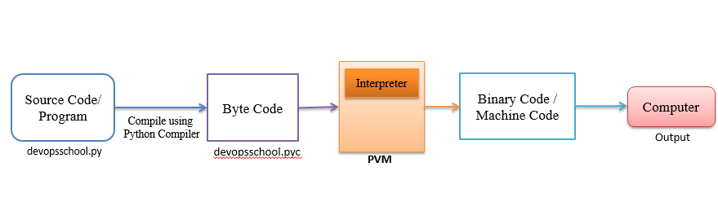
How Python codes are executed
Image Source: https://www.devopsschool.com/blog/python-virtual-machine/
Notes:
Source Code → Parsing → AST → Compilation → Bytecode → PVM → Binary Code
To Compile Python Files - python3 -m py_compile <text_2_ascii.py>
To view bytecode - python3 “python3 -m dis <text_2_ascii.py>”

Slide 13
Python Lexical and Syntax Analysis
Lexical analysis involves breaking down source code into tokens which are sent as input to the parser
Categories of tokens recognized by a python lexical analyzer program includes:
KEYWORD e.g. def, if, elif, with
IDENTIFIER e.g. print, int, str
OPERATOR e.g. +, >>
STRING/BYTE LITERAL e.g. “Hello”
NUMERIC LITERAL e.g. 331, 25
INDENT (which represents indentation)
DEDENT (dedentation)
DELIMITER (also called punctuator or separator)
NEWLINE (Logical Newline)
SYNTAX ANALYSIS
The Parser applies the defined grammar rules on the tokens to determine syntax correction and produce an AST (Abstract Syntax Tree).
Notes:
NEWLINE token is used for determining line continuation

Slide 14
CONCLUSION
Pros and Cons of Scripting Languages
Application of Scripting Languages

Slide 15
Pros and Cons of Scripting Languages
Easy to Learn
Slower Execution Speed
Easy to write and test
Pros
Pre-written codes for faster development
Cons
Portability Issues
More flexibility

Slide 16
Applications of Scripting Languages
01
Web Development
Interactive and dynamic websites are designed using scripting languages.
02
System Administration
Administrative tasks such as networking,, files management, backups, system security, performance testing can be done and automated using scripting languages
03
Game Development
Video game AI and mechanics are frequently created using scripting languages like Lua
04
Scientific Computing
Scientific computing and data analysis frequently use scripting languages like Python and MATLAB
05
Automation
Scripting languages can automate repetitive processes like renaming files or completing online forms
06
Prototyping
Before putting new concepts into practice in a more feature-rich and high performance language, fast prototyping and testing are frequently conducted using scripting languages

Slide 17
Thank You

